Slide 1
Software Product Line Engineering in Safety-critical Domains

Slide 2
1 Motivation

Slide 3
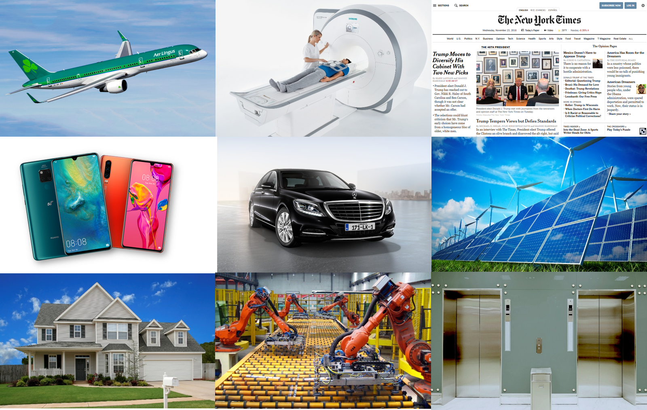
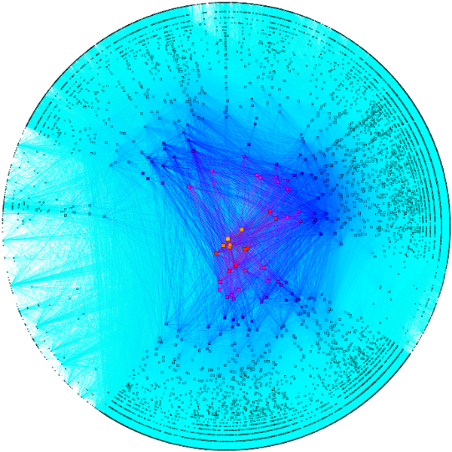
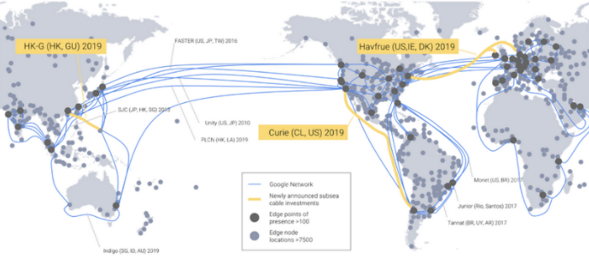
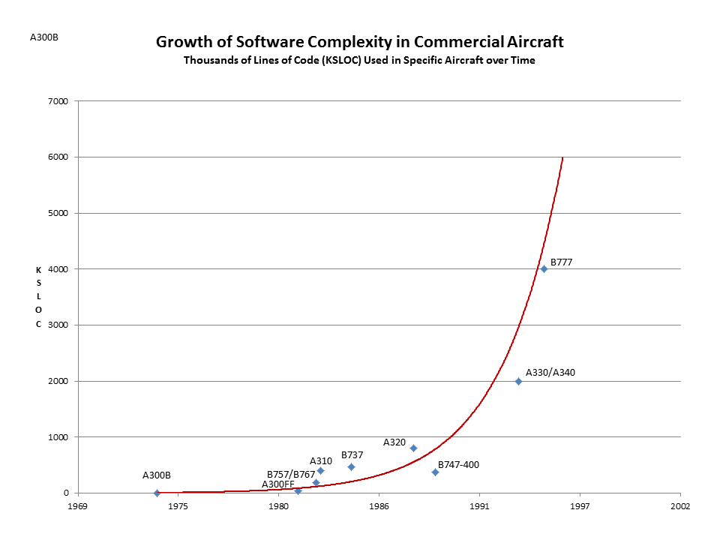
Challenges
High-level Concepts
Concrete Techniques
“Software is eating the world”
Model-driven Engineering
Abstraction
Models
Software Product Line Engineering
Complexity
Automation
Scale
Tools
AI and ML
Continous Software Engineering
Interactive Tools
Productivity of Engineers
Quality?
Constant Change
Automation?
Trustworthiness
Market Speed

Slide 4
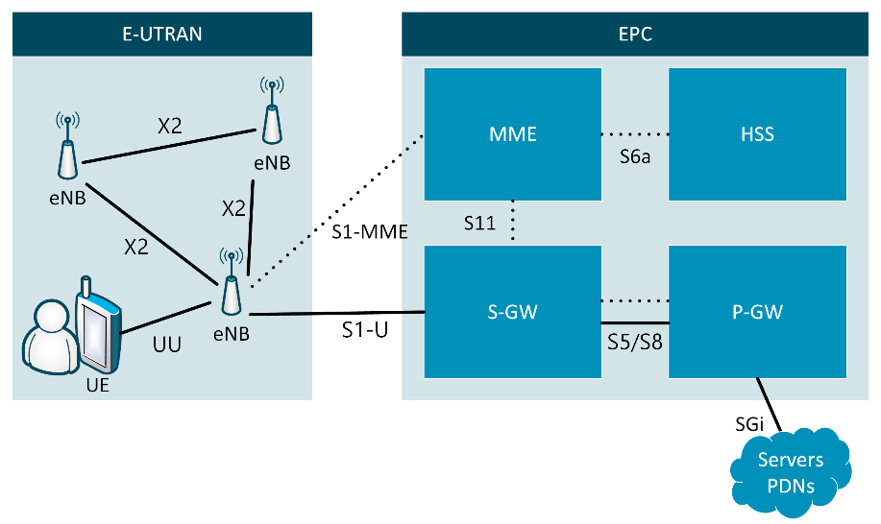
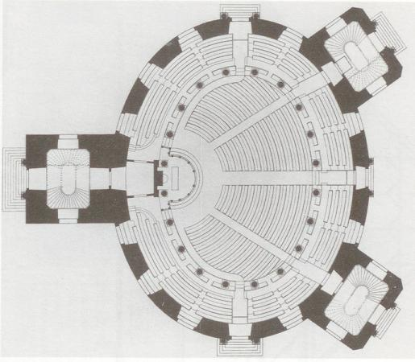
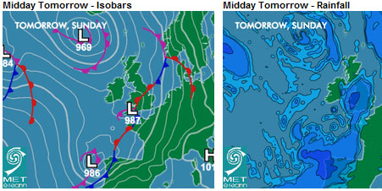
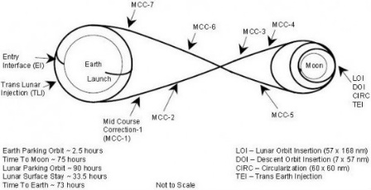


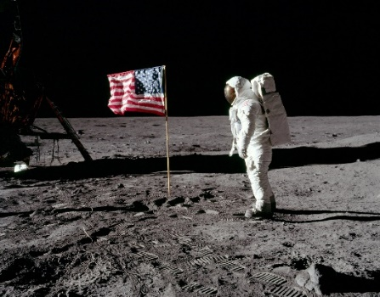

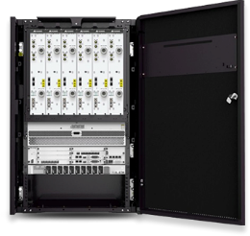


Why Models?
Construction
Weather
Spaceflight
Wireless Network
Model
Reality
Notes:
In science and engineering one way to gather knowledge and reduce complexity are models
Representation of Reality
Abstraction
Focusing on the relevant aspects → Modelling purpose
Intentionally ignoring irrelevant details
Avoiding complexity and costs of reality

Slide 5
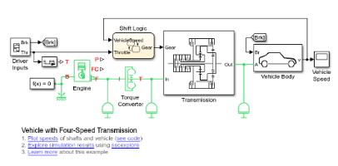


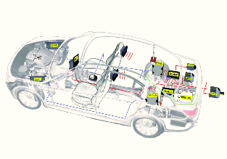
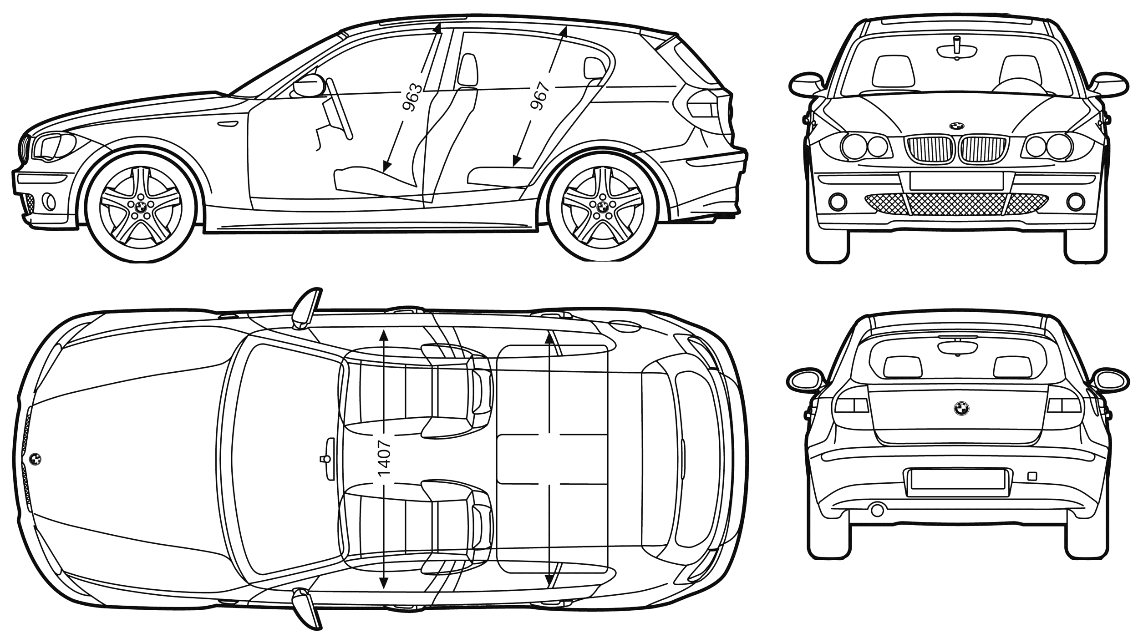
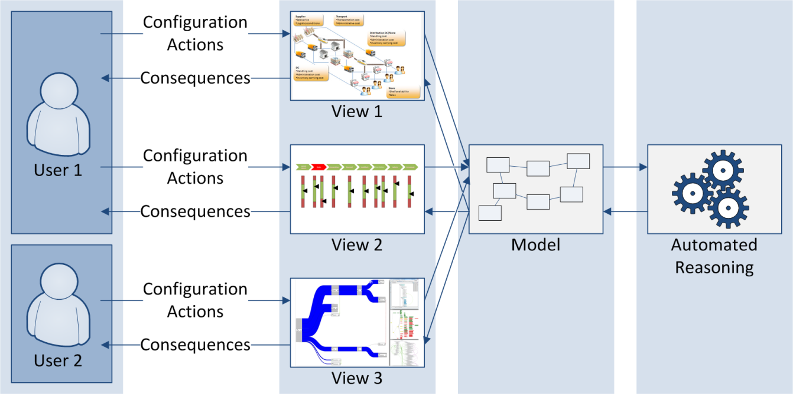
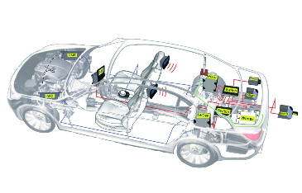
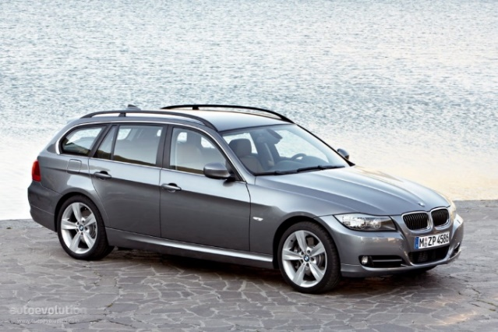
Model-driven Engineering
Formal Methods, Analysis,
Validation, Transformation
Visualisation, Interaction, Design
OK
Cancel
User
Model
Efficient Creation
(Automated Generation)
Purposeful Abstraction
Reality
[Stahl and Voelter 2006; Pleuss and Botterweck 2012]
Notes:
Representation of Reality
Abstraction
Focusing on the relevant aspects → Modelling purpose
Intentionally ignoring irrelevant details
Avoiding complexity and costs of reality
Automated generation: Just imagine constructing a house by taking a blue print and just pressing a button.

Slide 6
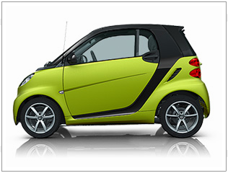
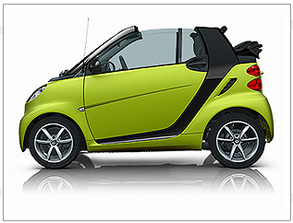
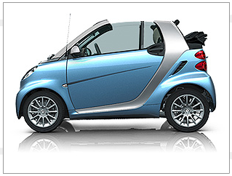
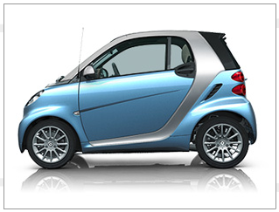
Where do Product Lines Come From?
Sucessful Product → More Products → Product Portfolio
Complexity Barrier and/or Need to Exploit Similarity (Market Pressure)
Must use Strategic Approach
CelciusTech Systems (Defense, Sweden)
Awarded two large contracts simulaneuosly → had to apply strategic approach
2000 SS2000 first entry into SPLC Hall of Fame http://splc.net/fame/celsiustech-systems-ab/
[Paul Clements, ICSE 2019 Keynote]

Slide 7
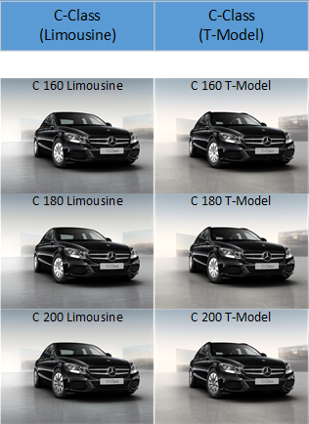
Many Variants
Source: Extracted from configurator at http://www.mercedes.de/

Slide 8
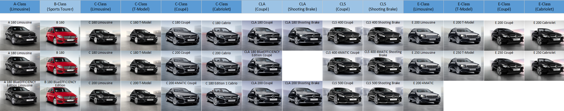
Many Variants
Source: Extracted from configurator at http://www.mercedes.de/

Slide 9
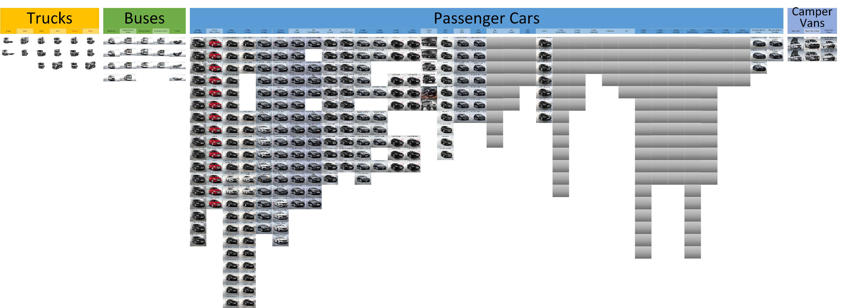
Many Variants
Source: Extracted from configurator at http://www.mercedes.de/

Slide 10

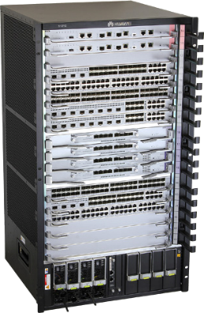
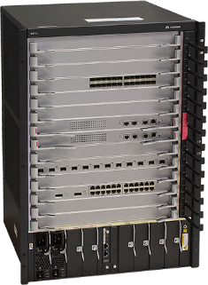

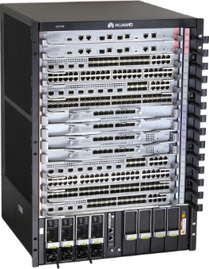
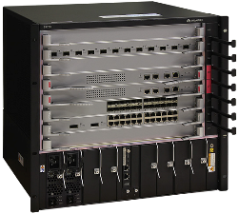


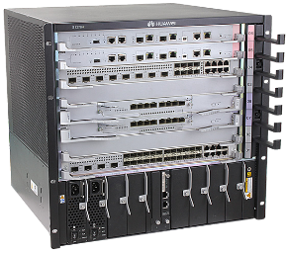
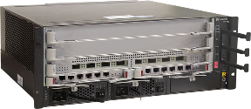

Product Lines
Huawei S9700 Series
(Network Switches)
Huawei BTS3900 Series (Wireless Network Base Transceiver Station)
Huawei S12700 Series (Network Switches)
Huawei Smartphones
Mercedes Passenger Cars

Slide 11
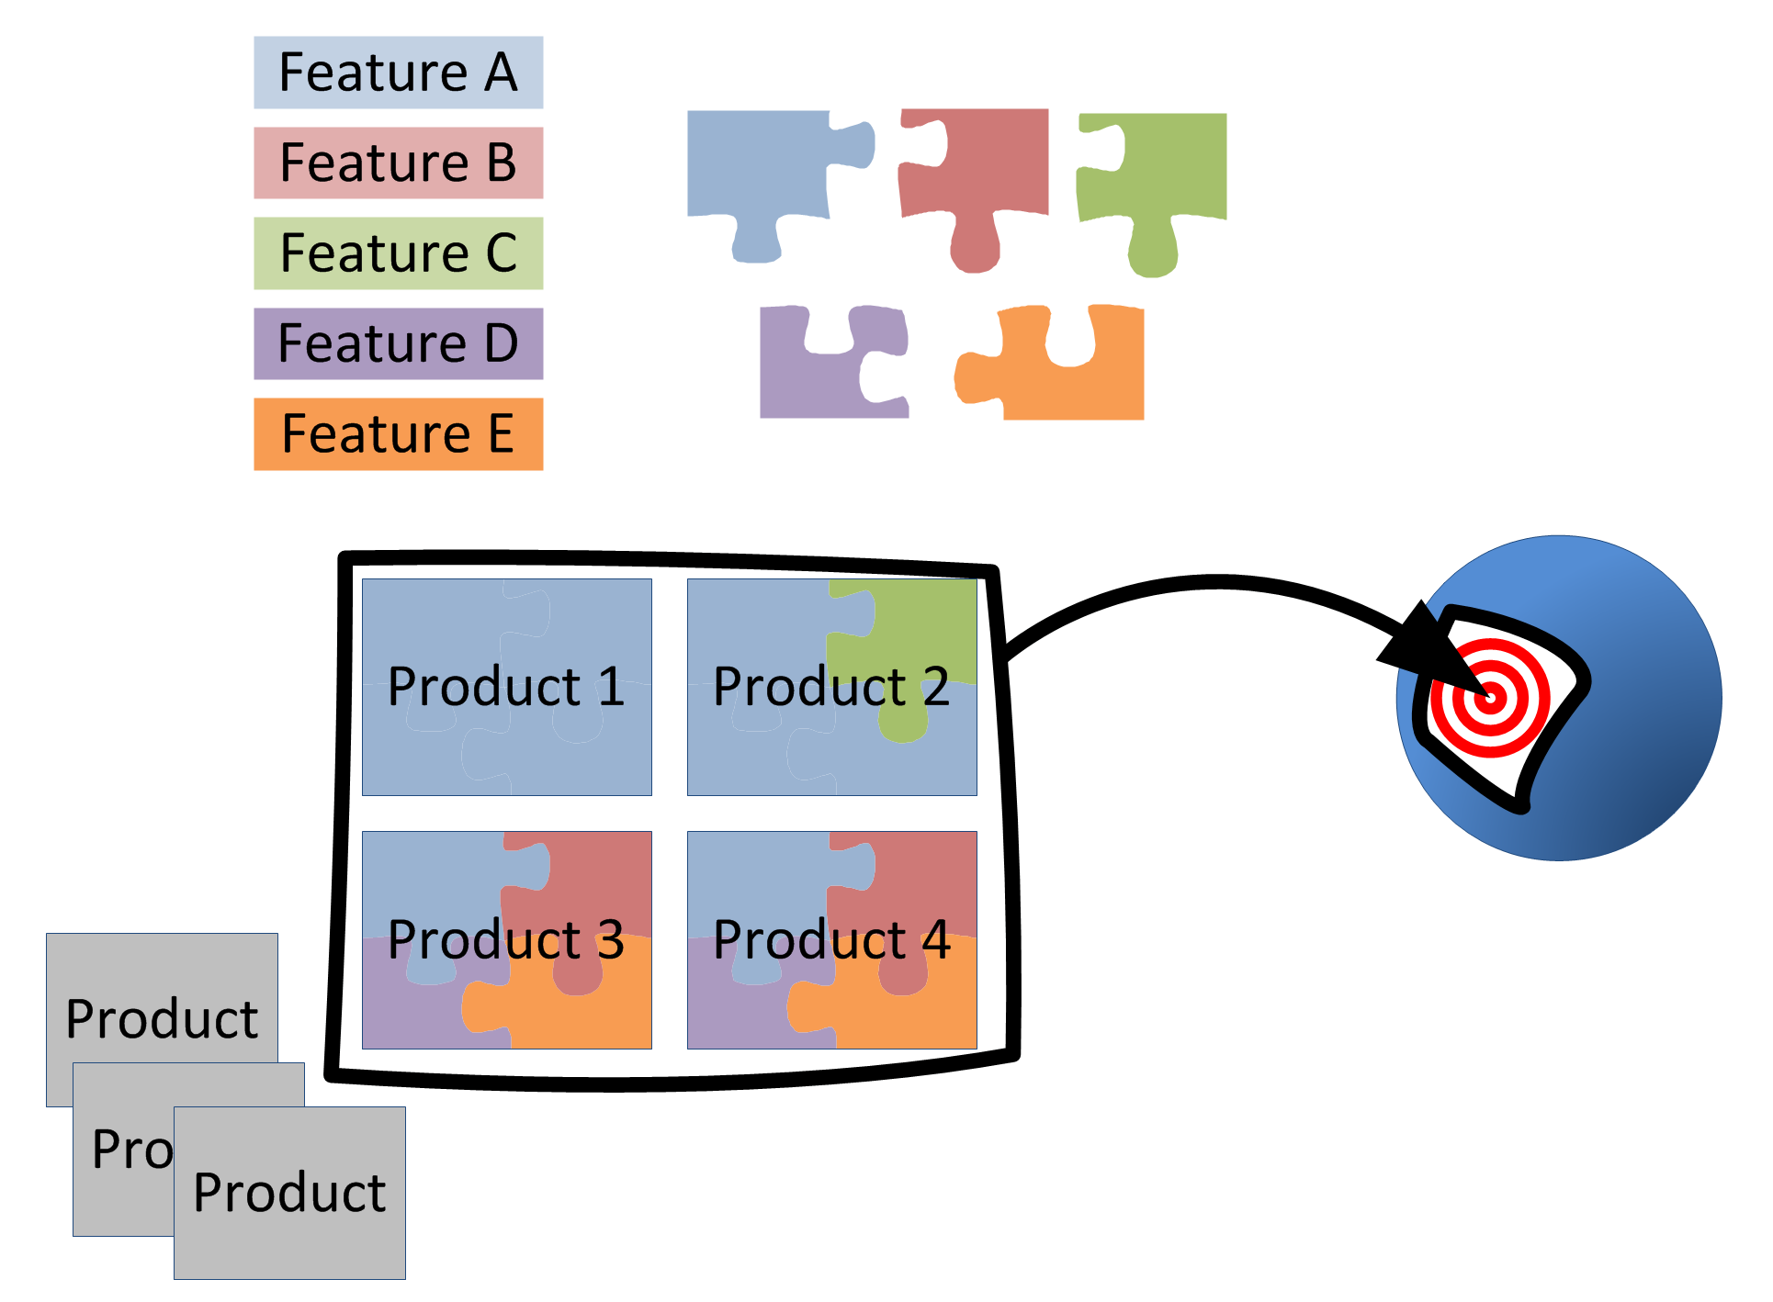
Product Lines
Developed from a common set of core assets in a prescribed way (strategic reuse)
Sharing a common, managed set of features
Targeting a market segment (scope)
Set of software intensive systems
[Clements and Northrop 2002]

Slide 12
2 Software Product Line Engineering

Slide 13


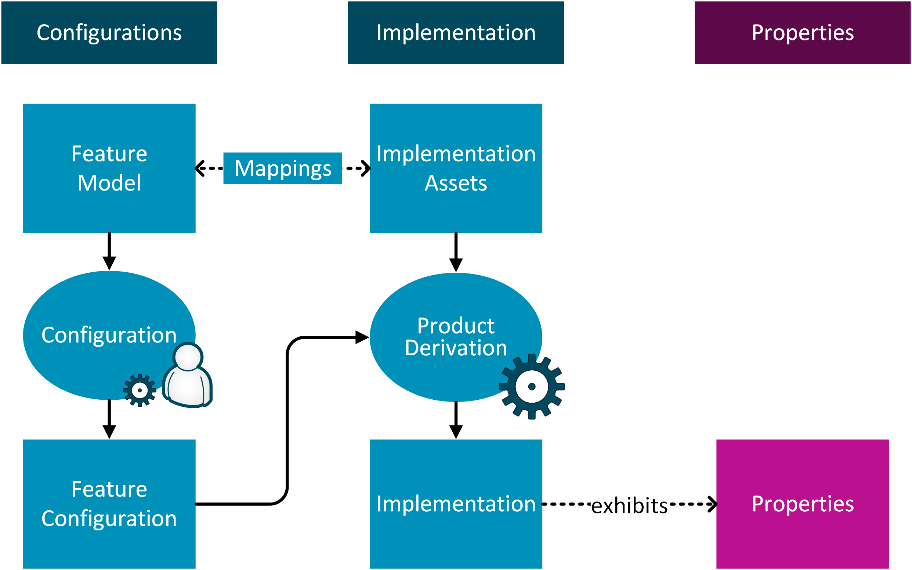
Software Product Line Engineering
[ACM Comp. Surveys 50(1), Information & Software Tech. 95; SSBSE 2016; VaMoS’14; ISSE 8(1); Software Tools for Technology Transfer 14(5)]

Slide 14
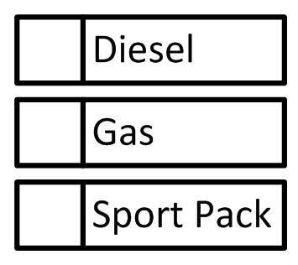
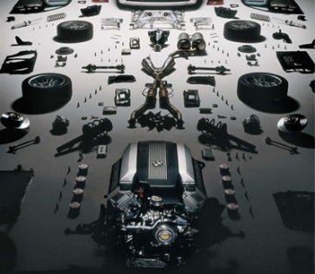
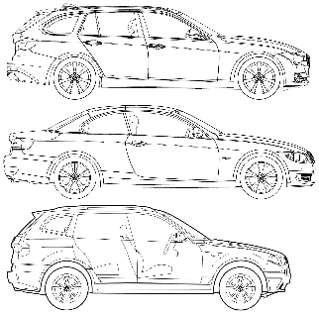
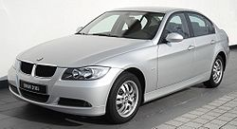
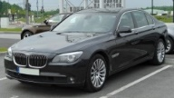
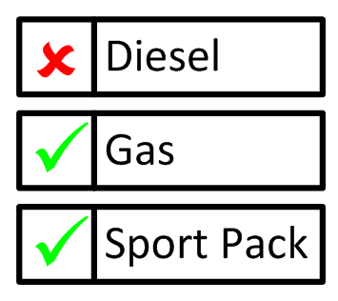
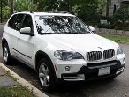
Software Product Line Engineering
€46,000
184PS
5.8l/100km
€65,200
245PS
6.l/100km
€48,800
150PS
5.0l/100km
[ACM Comp. Surveys 50(1), Information & Software Tech. 95; SSBSE 2016; VaMoS’14; ISSE 8(1); Software Tools for Technology Transfer 14(5)]

Slide 15
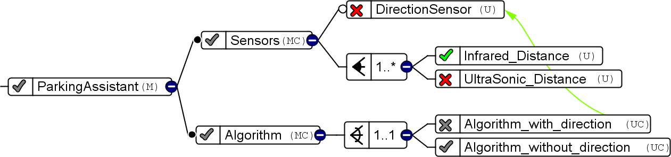
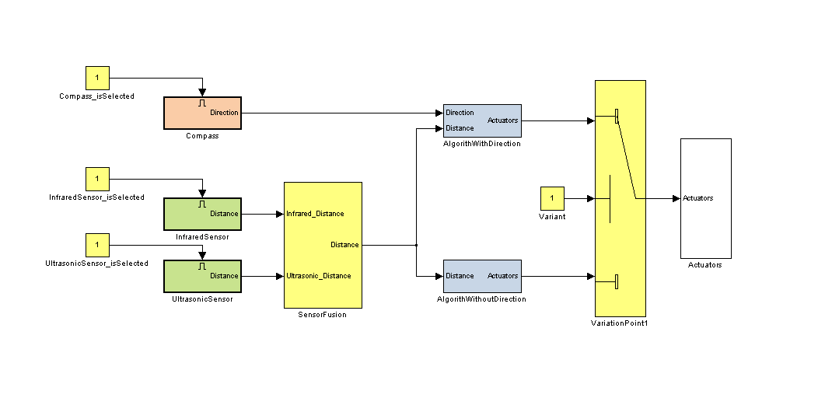
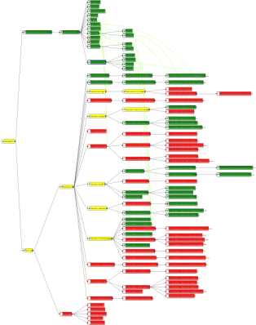
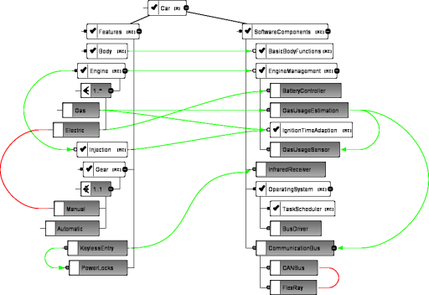
Software Product Line Engineering
How to Support Configuration?
How to Increase Level of Automation?
Interactive Configuration Tool S2T2,
Multi-objective Optimisation MILPIBEA
Various Techniques for Model-driven SE,
Domain-specific Approaches, e.g., Embedded, Aerospace, Automotive, ...
[ACM Comp. Surveys 50(1), Information & Software Tech. 95; SSBSE 2016; VaMoS’14; ISSE 8(1); Software Tools for Technology Transfer 14(5)]

Slide 16
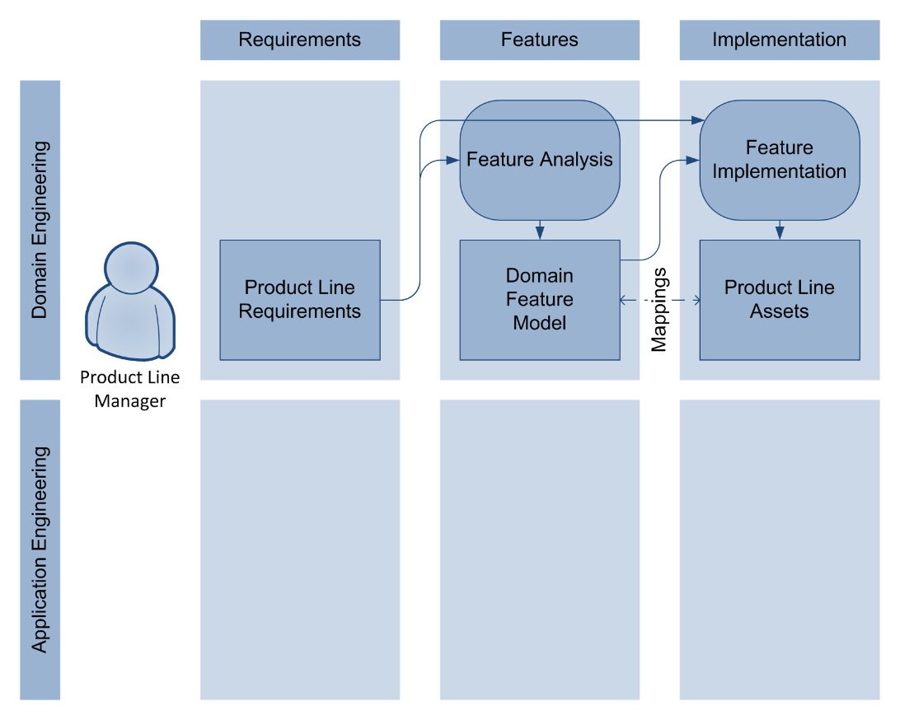
Product Line Engineering: Domain Engineering

Slide 17
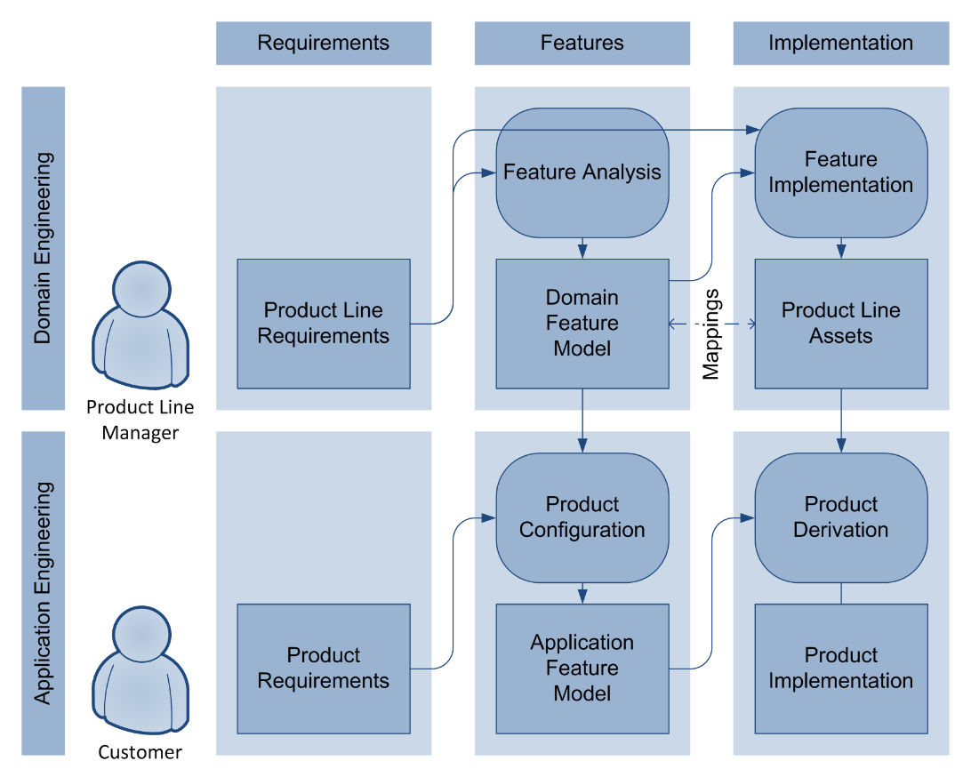
Product Line Engineering: Application Engineering

Slide 18
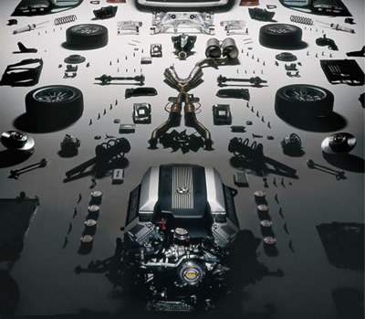
Product Line Engineering
Product Line Architecture
Product Line Assets

Slide 19
Product Line Engineering
Mapping
Product Line Architecture
Product Line Assets

Slide 20
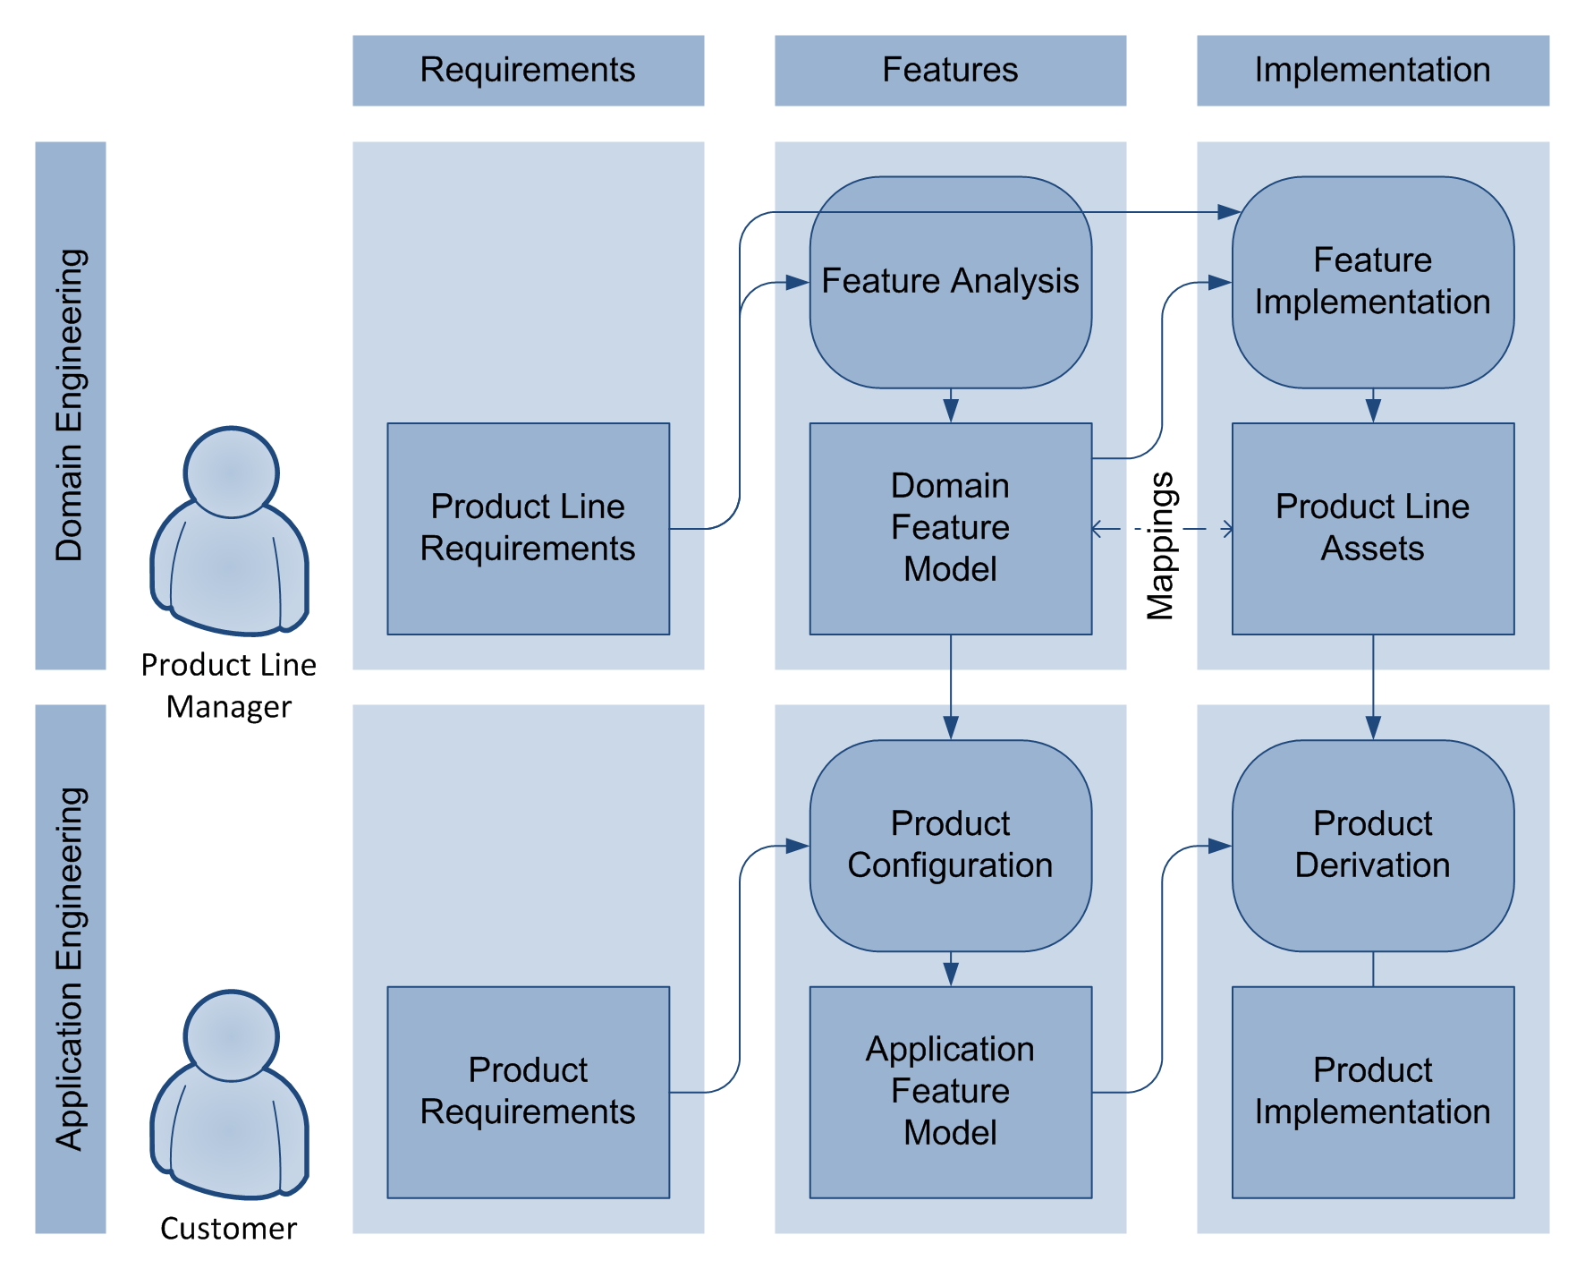
Product Line Engineering
Goal
Efficiency and Productivity
Scalability and Complexity Handling
by improving these processes

Slide 21
2.1 Product Configuration

Slide 22
Product Line Engineering

Slide 23
Visualisation Techniques (continued)

Slide 24
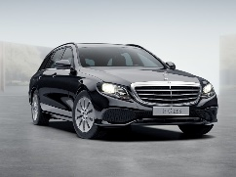
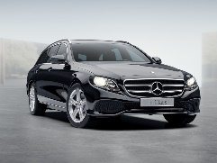
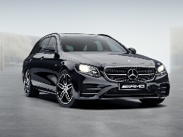
Configuration of Product Variants
Feature Model
Petrol xor Diesel
4 xor 6 cylinder
optional Sports Pack
Sports Pack requires 6 cylinder
Price [€]
Emissions [g CO₂/km]
Fuel consumption [l/100km]
configurations should conform to Feature Model
Petrol
4 Cylinder
yields product
€42,000
120 g/km
6.1 l/100km
No Sports Pack
Diesel
yields product
6 Cylinder
€55,000
136 g/km
5.2 l/100km
No Sports Pack
Petrol
6 Cylinder
yields product
€75,000
192 g/km
8.4 l/100km
Sports Pack
Notes:
One way to reduce complexity is to capture the available choices in a model
Choose product:
1) Provide interactive configurator, let user decide (but that would be another talk)
2) Look at product properties and try to find “the best” product

Slide 25
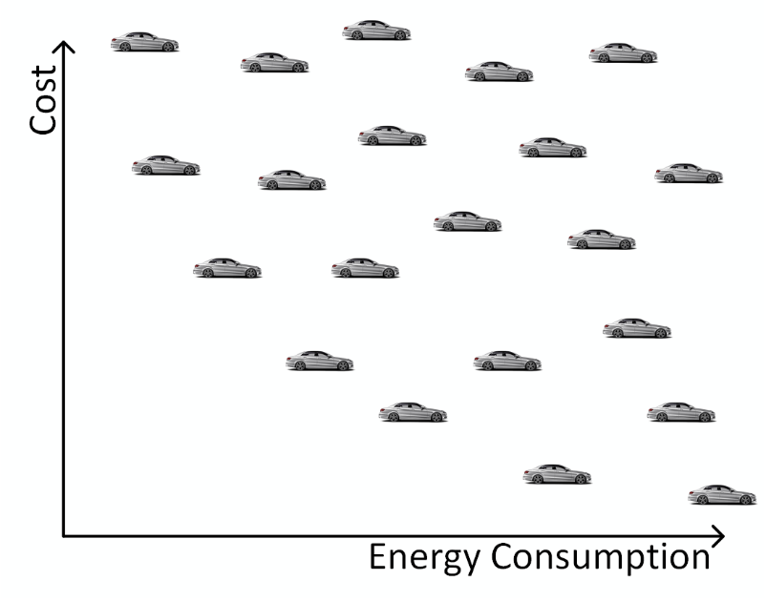
Multi-Objective Optimisation
Potential Products
Potential Products
Potential Products
Minimize
Goal: Optimize multiple objectives simultaneously
Minimize

Slide 26

Multi-Objective Optimisation
Pareto Front
Minimize
Named after Vilfredo Pareto
(1848-1923)
Goal: Optimize multiple objectives simultaneously
Minimize

Slide 27





Multi-Objective Optimization of Configurations
SATIBEA (State-of the-art)
MILPIBEA (our approach)
IBEA (Genetic Algorithm) to search good solutions
Mutation
Cross-over
Selection
MILP (Mixed Integer Linear Progr.) to heal individuals
1% Features changed
1% Constraints changed
Healing more efficient
Healed individuals closer to original ones
Healing
20% Features changed
10% Constraints changed
IBEA = Indicator-Based Evolutionary Algorithm
[Brevet, Saber, Botterweck, Ventresque, SSBSE 2016]

Slide 28
2.2 Product Derivation

Slide 29
Product Line Engineering: Application Engineering

Slide 30
Product Derivation in a Embedded Systems DSL
[BPK09] Botterweck, G.; Polzer, A. and Kowalewski, S. Using Higher-order Transformations to Derive Variability Mechanism for Embedded Systems ACES-MB 2009, collocated with MODELS, Denver, CO, USA, October, 2009 , 68-82

Slide 31

Product Derivation in a Embedded Systems DSL
[BPK09] Botterweck, G.; Polzer, A. and Kowalewski, S. Using Higher-order Transformations to Derive Variability Mechanism for Embedded Systems ACES-MB 2009, collocated with MODELS, Denver, CO, USA, October, 2009 , 68-82

Slide 32

Product Derivation in a Embedded Systems DSL
[BPK09] Botterweck, G.; Polzer, A. and Kowalewski, S. Using Higher-order Transformations to Derive Variability Mechanism for Embedded Systems ACES-MB 2009, collocated with MODELS, Denver, CO, USA, October, 2009 , 68-82

Slide 33
3 Transition to SPLE

Slide 35
Different Approaches to Product Lines
Proactive
Develop PL assets first
Scoping, predictable target segment required
Upfront investment
Opportunity to structure PL and architecture as a whole
Reactive
Develop products first
Derive PL from products
Related approaches: Mining/Reverse Engineering
Incremental
Develop the PL in phases
Can be combine with both proactive and reactive approach

Slide 36

SEI Adoption Factory Pattern
[Clements et al. 2006, Northrop 2008]

Slide 37
4 Product Line Evolution

Slide 38

Product Line Evolution
[Botterweck and Pleuss 2014]

Slide 39

Product Line Evolution
[Botterweck and Pleuss 2014]

Slide 40

Product Line Evolution
[Botterweck and Pleuss 2014]

Slide 41

Product Line Evolution
[Botterweck and Pleuss 2014]

Slide 42

Product Line Evolution
[Botterweck and Pleuss 2014]

Slide 43

Product Line Evolution
[Botterweck and Pleuss 2014]

Slide 44
5 Variation/Automation and Quality

Slide 45

Verification and Testing

Slide 46
6 Successful in Practice

Slide 47
Prerequisuites
Enabling technologies: configuration/assembly of products (e.g. for software: OO, components, binding, ...)
Process maturity
Domain
Stability
Expertise, predictive knowledge
Otherwise: return on investment not possible

Slide 48

Develoment Costs
[Pohl et al. 2005, Weiss and Lai 1999]

Slide 49

Time-to-market
[Pohl et al. 2005]

Slide 50




Sucessful applied in practice, e.g.,
Avionics Systems
Engine Control Software
Marine Command and Control Systems
Telecommication Systems
Printer Firmware
RAID Storage Controllers
Financial Software
Mobile Phones
Medical Systems
Consumer Electronics
Acquisition Management Systems
Power Systems

Slide 51
Benefits of Product Lines
High quality
Reduced time to market
Market dominance
Market agility
Product alignment
Low cost production
Low cost maintenance
Mass customization
Reduced maintenance effort
Improved Efficiency and Productivity
[Clements and Northrop 2002, Northrop 2008]

Slide 52
Other effects
Scalability and complexity handling
Managment of evolution
Improved cost and time estimation

Slide 53
5 Current Research

Slide 54
Application of Machine Learning
Machine Learing in Configuration
E.g., learning a configuration space from a limited number of configurations

Slide 55




Design Space Exploration
Design Problems That Can be Modelled as Graphs
Civil Engineering
Aeronautical Engineering
Electrical Wiring of House
Plumbing of House
Electrical Wiring Harness of a Plane
Environmental Control System of a Plane

Slide 56

Design Space Exploration

Slide 57




Design Space Exploration
How can we support engineers to make sense of large sets of designs? Which parts can be automated?
Usability Engineering
Interactive Visualisation
Tools to Compare Large Sets of Designs
Graph Analysis
Combinations of ML and Graph Approaches (e.g., Graph Embedding)

Slide 58
Summary

Slide 59
TBD

Slide 60
Appendix

Slide 61


Interactive Visual Configuration
Interactive techniques for the configuration of large and complex feature models [BSP09]
Co-configuration of feature and component models [BPK09]
2.5D and 3D visualisations in PLE configuration [CNP+08, CBH+09, CTB+09, CBH10, CHT+10]
Visualisation of product attributes during configuration [ScBo10]

Slide 62






Product Configuration (Integration of concepts)
[BJS09] Botterweck, G.; Janota, M. and Schneeweiss, D. A Design of a Configurable Feature Model Configurator, Proceedings of the 3rd International Workshop on Variability Modelling of Software-Intensive Systems (VAMOS 09), January, 2009 , 165-168

Slide 63








Notes:
What do we see here? There’s a plane, an MRI scanner, a house, a car, …
But what I actually see is software systems. Any system in our everyday life will become a software system.
Complex
150 Mio LOC. One thousand times as much as …
100 ECU, little computers
Many different aspects to consider, e.g., fuel consumption, safety, cost of manufacturing How do we build such a complicated system?

